Slide 1
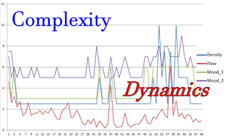
Cpt 1 Management Framework
The theory
Background: Characteristics of Complexity Management
Not linear.
Multiple interdependencies.
Amplification and dramatic
change.
Rare/Catastrophic risks
Uncertainty
Emergent behaviour.

Slide 2
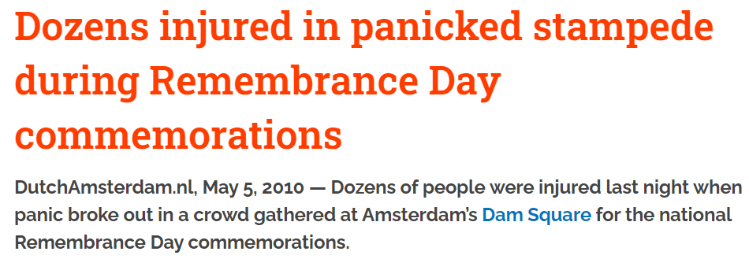
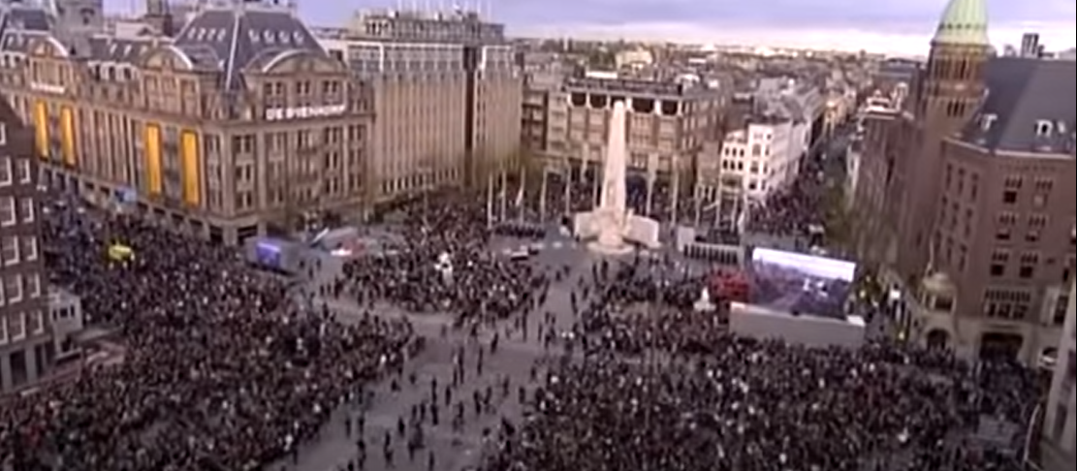
https://youtu.be/ezTaAtgxmNA

Slide 3
Underlying system
This system is used in all the chapters:
Factors
Inputs
Processes
Outputs
Tools and techniques

Slide 4
Factor Analysis of crowds
Crowd and event characteristic that significantly contribute to the risk
World Health Organisation
Type of event
Activity Level
Duration
Occurrence
Season
Participant; Origins, (Local or International) Health status and density
Venue Characteristics (out door Indoor..)
Alcohol
Catering
Likely Drug use
Current medical services
Hygiene and Sanitation Services.

Slide 5
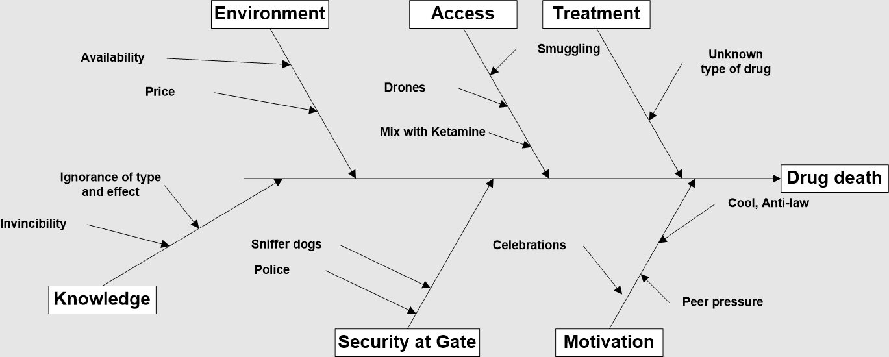
Casual analysis: drug deaths at events

Slide 6
Phase change
In the dynamics of crowds, factors are not static. They can dramatically change.
Factors can be used to describe the ‘state’ of the crowd at a point in time. This is a snapshot view.
What are the factors that enable time critical decision making in on-site crowd management?
Andrew Tatrai posits these are: mood, flow, density

Slide 7
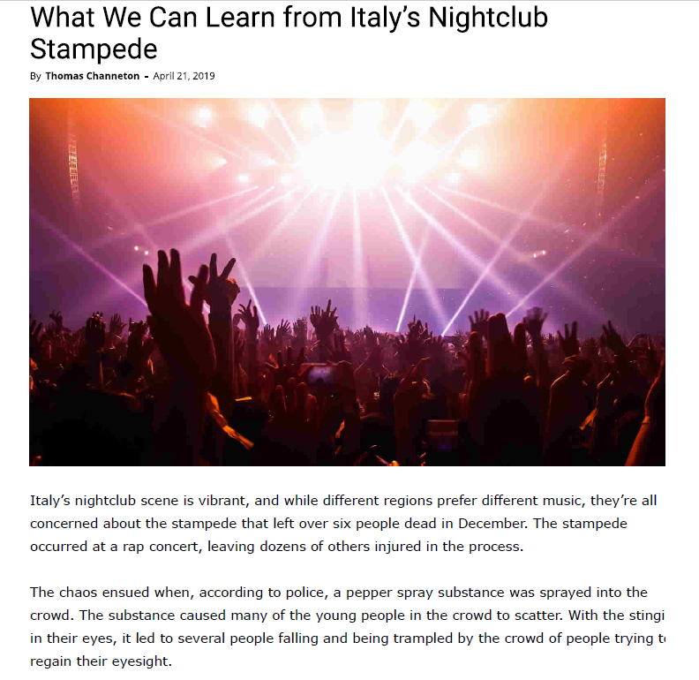
What was the “state” of the crowd?
What was the cause?
What were the contributing factors?

